Slide 1
CSSE 220
Design Principle #3
Encapsulation

Slide 2
Major Goals of ALL Program Design
Suppose someone has written a program that works and it has no bugs, but it is poorly designed.
What does that mean?
Why do we care?
There are two major goals:
It would be good if were easy to understand
It would be good if it were easy to modify
Q1
Notes:
Animation for the two major goals

Slide 3
CSSE220 Design Principles
Make sure your design allows proper functionality
Must be able to store required information (one/many to one/many relationships)
Must be able to access the required information to accomplish tasks
Data should not be duplicated (id/identifiers are OK!)
Structure design around the data to be stored
Nouns should become classes
Classes should have intelligent behaviors (methods) that may operate on their data
Functionality should be distributed efficiently
No class/part should get too large
Each class should have a single responsibility it accomplishes
Minimize dependencies between objects when it does not disrupt usability or extendibility
Tell don't ask
Don't have message chains
Don't duplicate code
Similar "chunks" of code should be unified into functions
Classes with similar features should be given common interfaces
Classes with similar internals should be simplified using inheritance
Avoid all type-predicated code by using inheritance

Slide 4
E.g., What if there were no String class?
Instead, what if we just passed around arrays of characters - char[]
And every String function that exists now, would instead be a function that operated on arrays of characters
E.g., char[] stringSubstring(char[] input, int start, int end)
Would things be any different? Discuss this with the person next to you.
Notes:
Hopefully they will come up with at least two ideas:
Makes it less convenient to know what functions exist
Stuck implementing strings as character arrays

Slide 5
Concatenate… compare
String stringName1 = "jason";
String stringName2 = "yoder";
String stringConcat = stringName1.concat( stringName2 );
System.out.println( stringConcat );
----------------------------------------------------------
char[] charName1 = {'j','a','s','o','n'};
char[] charName2 = {'y','o','d','e','r'};
char[] charConcat =
new char[charName1.length + charName2.length];
for (int i = 0; i < charName1.length; i++) {
charConcat[i] = charName1[i];
}
for (int i = 0; i < charName2.length; i++) {
charConcat[charName1.length + i] = charName2[i];
}
System.out.println( Arrays.toString(charConcat) );
Notes:
Which is easier to use?
Which is easier to understand?
Clearly classes make sense

Slide 6
Class sizes
Why not put all the Math utilities in the String class?
Math Java docs
String Java docs
We could just get anything we need done with Strings and Math with one library instead of two!
Q2
Notes:
Makes it harder to know what is meant when you have a function say “add” or length
Means you are loading more things that you might actually need
Try to keep conceptual separation!

Slide 7
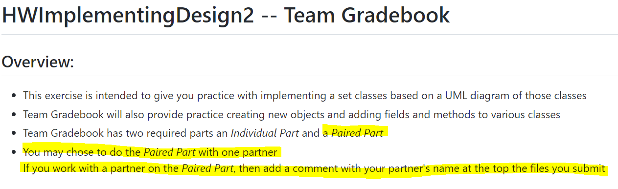
Pairing Up
On a small piece of paper write down either:
A list of people you’d be interested in working with
OR that you don’t know anyone BUT you’d like to work with someone
You prefer NOT to work with anyone
Hand these to our TA who will try to pair people: up

Slide 8
Do the in-class activity
Constellation Problem: A particular program is designed to load constellations from datafiles and draw them on the screen. The datafiles include the names of the constellations and details about star location, size, and color as well as which stars ought to be connected to draw the constellation. Depending on the star data, each star should be drawn differently (e.g., right size, right color).
To Do #1 Identify all the primary nouns – those that are eligible to be a Java class
A primary noun is a noun in the problem that has attributes (other nouns)
Nouns that designate actors of the system (i.e., The user can click…) can be excluded
To Do #2 Write down the other nouns (attributes) associated with the primary nouns
To Do #3 Identify all the verbs
To Do #4 Identify which primary nouns are worked on by the verbs
To Do #5 Design a system using UML to handle this problem
If you do this all well, then you should hopefully be able to make classes where:
Each primary noun becomes a Class
Each attribute (other noun) becomes a field for its respective class
Each verb becomes the method for the respective class
Notes:
20-25

Slide 9
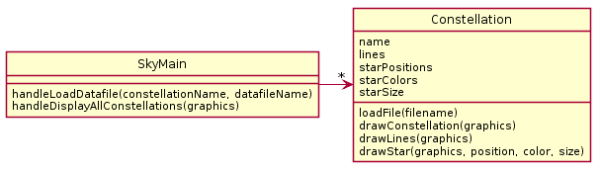
Explain the problem with the given solution.
Then start to propose a UML solution of your own.

Slide 10
3a. Constellation does everything (except maybe the parsing done by main).
Finish your own solution!

Slide 11
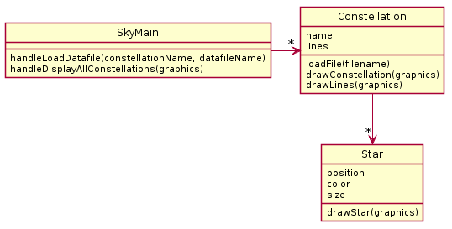
Do the in-class activity
Constellation Problem: A particular program is designed to load constellations from datafiles and draw them on the screen. The datafiles include the names of the constellations and details about star location, size, and color as well as which stars ought to be connected to draw the constellation. Depending on the star data, each star should be drawn differently (e.g., right size, right color).
If you do this all well, then you should naturally be able to make classes where:
Each primary noun becomes a Class
Each attribute (other noun) becomes a field for its respective class
Each verb becomes the method for the respective class

Slide 12
Do the in-class activity
Constellation Problem: A particular program is designed to load constellations from datafiles and draw them on the screen. The datafiles include the names of the constellations and details about star location, size, and color as well as which stars ought to be connected to draw the constellation. Depending on the star data, each star should be drawn differently (e.g., right size, right color).
If you do this all well, then you should naturally be able to make classes where:
Each primary noun becomes a Class
Each attribute (other noun) becomes a field for its respective class
Each verb becomes the method for the respective class

Slide 13
Do the in-class activity
Constellation Problem: A particular program is designed to load constellations from datafiles and draw them on the screen. The datafiles include the names of the constellations and details about star location, size, and color as well as which stars ought to be connected to draw the constellation. Depending on the star data, each star should be drawn differently (e.g., right size, right color).
If you do this all well, then you should naturally be able to make classes where:
Each primary noun becomes a Class
Each attribute (other noun) becomes a field for its respective class
Each verb becomes the method for the respective class

Slide 14
A possible solution
Often times you need to find and extract a new class when things get complex.
Here, Star class was extracted from original Constellation class

Slide 15
Your turn!
Try to design UML for the following scenario

Slide 16
Do the in-class activity
Pizza Restaurant Problem: A pizza restaurant needs to calculate the cost of orders and record what pizzas need to be made. An order consists of a number of pizzas each of which might have toppings as well as a customer’s name and an order date. Each pizza costs $8 with no toppings. The first 2 toppings cost $2 apiece. Additional toppings beyond that cost $1. If a pizza has just peppers, onions, and sausage - that's "The special" and it costs $12.
To Do #1 Identify all the primary nouns – those that are eligible to be a Java class
A primary noun is a noun in the problem that has attributes (other nouns)
Nouns that designate actors of the system (i.e., The user can click…) can be excluded
To Do #2 Write down the other nouns (attributes) associated with the primary nouns
To Do #3 Identify all the verbs
To Do #4 Identify which primary nouns are worked on by the verbs
To Do #5 Design a system using UML to handle this problem
If you do this all well, then you should hopefully be able to make classes where:
Each primary noun becomes a Class
Each attribute (other noun) becomes a field for its respective class
Each verb becomes the method for the respective class
Notes:
38-48

Slide 17
UML
What classes did you have?
Based on the primary nouns in the story problem
And their fields? Based on other nouns
What methods go in PizzaMain class?
Based on the verbs in the story problem
Where did you put the metod getCostOfPizza()?
Notes:
Hopefully students answer:
Pizza and Order
Hopefully most say Pizza, ask why they chose that and if anyone chose order why they chose that

Slide 18
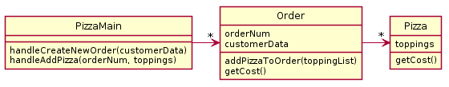
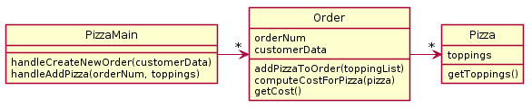
Solution A
Solution B
Which is better? Discuss with someone nearby!
Notes:
Discuss after returning from break

Slide 19
Solution A
Solution B
Conceptually, calculating costs could belong in either Order or Pizza
But Order (in Solution B) is doing a lot of stuff, and Pizza is just a dumb data holder. ("dumb" means few methods, in this case just a getter)
So, by moving the computeCostForPizza functionality from Order to the Pizza, we improve the design and get Solution A
This moving from the hasA class to the has'ed class is sometimes call pushing functionality down
Notes:
Solution A is better!

Slide 20
Alternate Pizza Restaurant Read Carefully!
Consider now the ability to add a discount to an order, such that a coupon can be added to an order and then it changes how the cost is calculated. A coupon may offer a discount percentage for toppings (50% off all toppings) and/or a percentage off of entire orders. In addition, there should be a way to calculate how long it takes to create a pizza based on its size and toppings.
Design a UML diagram to model this.
PAUSE HERE for 5-10 minutes!
Try to make your own improved design
Using plantuml is good practice!

Slide 21
UML
What classes did you have?
Where did you put “getCost()”?
Notes:
Hopefully students answer:
Pizza and Order
Hopefully most say Pizza, ask why they chose that and if anyone chose order why they chose that

Slide 22
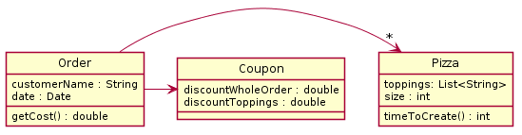
One Solution
3. Functionality should be distributed efficiently
No single part of the system should get too large
Each class should have a single responsibility it accomplishes
Notes:
Mention here that we are listing all the types explicitly, but that is not usually required
Mention that we are omitting PizzaMain here for space, but that it normally should be included

Slide 23
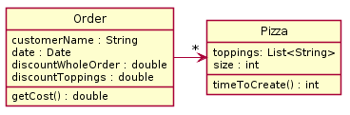
Do we need Coupon or Topping?
It depends, do the classes do anything with their data, or are the just data classes that simply all you to get and set values?
Notes:
If we are planning to expand the coupon class later, then it may make sense to create a class for it to be prepared to re-use and modify the code.

Slide 24
Rule of Thumb - Avoid Data Classes!
A data class is a class that just contains getters and setters
Often, we think of Data Classes as violating a principle of OOD called encapsulation because they aren’t in control of their own data – they are just dumb repositories for other classes to use ("dumb" means few methods, e.g., just a getters and setters)
Usually, you can improve a data class by finding functionality to add to them by creating a method that implements that functionality

Slide 25
Your turn!
Try to design UML for the following scenario

Slide 26
Do the in-class activity
Car Rental Problem: A rental company has many vehicles that it rents. Vehicles have a year, make, and model and a stock photo advertising the vehicle on file. There are multiple vehicles that are the same year, make, model.
However, additional information on the specific physical vehicles is also required. For instance, each physical vehicle has a VIN (vehicle identification number unique to each), a description of any damage to it, and the driver’s license numbers of everyone who has rented it.
The company also needs to be able to print out the damage report of a vehicle given a VIN. The company also must print out an advertisement using the stock photo for a given year, make, and model.
To Do #1 Identify all the primary nouns – those that are eligible to be a Java class
A primary noun is a noun in the problem that has attributes (other nouns)
Nouns that designate actors of the system (i.e. The user can click…) can be excluded
To Do #2 Write down the other nouns (attributes) associated with the primary nouns
To Do #3 Identify all the verbs
To Do #4 Identify which primary nouns are worked on by the verbs
To Do #5 Design a system using UML to handle this problem
Notes:
22-32

Slide 27
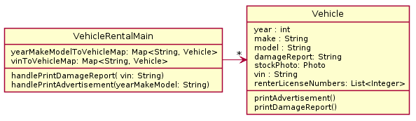
Operable but poor solution
What is wrong?
PAUSE HERE for a couple minutes!
Try to see what you can think might be wrong
When you have an idea, then continue
Notes:
Doing two different things much, (data duplication)
@startuml
skinparam style strictuml
class VehicleRentalMain {
yearMakeModelToVehicleMap: Map<String, Vehicle>
vinToVehicleMap: Map<String, Vehicle>
handlePrintDamageReport( vin: String)
handlePrintAdvertisement(yearMakeModel: String)
}
class Vehicle {
year : int
make : String
model : String
damageReport: String
stockPhoto: Photo
vin : String
renterLicenseNumbers: List<Integer>
printAdvertisement()
printDamageReport()
}
VehicleRentalMain -> "*" Vehicle
@enduml

Slide 28
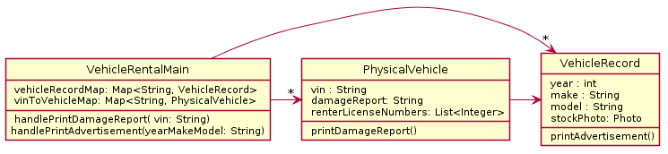
Better Solution
There are two different things:
Actual physical vehicle
Records of specific vehicles
Class has own behaviors (reports)
Used for specific purposes, specific data
Notes:
@startuml
skinparam style strictuml
class VehicleRentalMain {
vehicleRecordMap: Map<String, VehicleRecord>
vinToVehicleMap: Map<String, PhysicalVehicle>
handlePrintDamageReport( vin: String)
handlePrintAdvertisement(yearMakeModel: String)
}
class VehicleRecord {
year : int
make : String
model : String
stockPhoto: Photo
printAdvertisement()
}
class PhysicalVehicle {
vin : String
damageReport: String
renterLicenseNumbers: List<Integer>
printDamageReport()
}
VehicleRentalMain -> "*" VehicleRecord
VehicleRentalMain -> "*" PhysicalVehicle
PhysicalVehicle -> VehicleRecord
@enduml

Slide 29
Design Principles
3. Functionality should be spread throughout the system
No single part of the system should get too large
Each class should have a single responsibility it accomplishes

Slide 30
Object-Oriented Design Term: Encapsulation
Makes your program easier to understand by
Grouping related stuff together (i.e., capsule)
Each class has ONE JOB!
Rather than passing around data, pass around object instances (created from a class) that:
Provide a powerful set of methods that work on the data stored inside the object
These methods protect the private data stored inside the object from being used incorrectly
Q2

Slide 31

Object-Oriented Design Term: Encapsulation
Makes your program easier to understand by…
Saving you from having to think about how complicated things might be
Puts everything you need in one place
Using put and get in HashMap
Implementing HashMap

Slide 32
Object-Oriented Design Term: Encapsulation
Makes your program easier to understand by…
Saving the client of the object from having to think about how the class works
Puts everything you need in one place
Using put and get in HashMap
Implementing HashMap

Slide 33
Object-Oriented Design Term: Encapsulation
Makes your program easier to change by…
Allowing the class implementer to change how data internal to the class is represented
But for the client, usage stays the same
STILL Using put and get in HashMap
Q3
Notes:
This is done without changing your interface.

Slide 34
Design Problem 2
Due Wednesday night 11:55pm
We will go over the solution at the start of next class!
https://github.com/RHIT-CSSE/csse220/blob/master/Homework/DesignProblems/DP2/DP2.md
Following HW will be ImplementingDesign2 (code the solution)

Slide 35
TA will provide suggested list of partners either now or via electronic communication later

Slide 36
Turning in UML for ImplementingDesign1
We have shown you a solution, but we want you to learn how to use tools to generate them
http://www.plantuml.com/plantuml
Free web generator
Integration with Google Docs
http://www.umlet.com/
Install program (works offline)
Notes:
Remind students to have OO Principles sheet handy and that it is found on the website
Show students briefly how to generate UML from plantuml web generator (generates png that can be easily saved)

